Slide 2
Introduction to Python using Visual Studio Code
Speaker: Cyprian Abeiku Maison

Slide 3
About
Microsoft Learn Student Ambassador
Electrical/Electronic Engineering Student
Skills & Interests
Python Programming
C/C++ Programming
AI & Machine Learning
Internet Of Things
Contact: cyprian.maison@studentambassadors.com

Slide 4

Agenda
Computer Programming
Python Programming (Definition, Uses, Benefits)
IDEs & Code Editors
Visual Studio Code
How to install VS Code
How to install Python
Setting up Python in Vs Code
Run First Python Code
Guess Game Project Overview
Things to Know
Learning Resources
Practical Session

Slide 5
Computer Programming
Computer programming is the process of designing and building an executable computer program to accomplish a specific computing result or to perform a specific task.
This program is written in a programming language i.e. C, JavaScript, Java, C++, C#, Dart, R, Python etc.

Slide 6
What is Python?
Python is an interpreted high-level general-purpose programming language.
Python is an interpreted language because it goes through an interpreter, which turns code into the language understood by the computer’s processor.
Python is considered high-level because it is closer to human language
and further from machine language.

Slide 7
Uses of Python
AI and Machine learning
Data Science, Analytics and Visualization
Web Development
Game development
Search Engine Optimization
Automation
Natural Language Processing

Slide 8
Benefits of Learning Python
Python is easy to read, write, and learn
Python is extremely versatile, with vide variety of uses
Python is in high demand for jobs
Python has an incredibly supportive community
Automatic memory management
Stepping stone to other languages
It’s free to use(open source)!

Slide 9
IDEs & Code Editors
An Integrated development environment (IDE) and a Code Editor are both software used to write and edit code, and build applications, all in a single graphical user interface.
Examples:
Microsoft Visual Studio, Microsoft Visual Studio Code, PyCharm, Sublime Text, Atom, etc.
Default Python IDE: Integrated Development and Learning Environment (IDLE)

Slide 10
Microsoft Visual Studio Code (VS Code)
Visual Studio Code is a code editor with support for development operations, made by Microsoft for Windows, Linux and MacOS Devices. Features of VS Code _ Integrated CLI (Command Line Interface) _ Support for Multiple Languages _ Extension Market Place _ Keyboard shortcuts _ Split view _ Debugging _ Themes & Customization _ Status Bar

Slide 11
How To Install VS Code
Go to https://code.visualstudio.com/.
Select the Stable Version for your Operating System and Download.
After Download Finishes,
3. Open VSCodeUserSetup-x64 in your downloads folder.
4. Follow the prompt, the default selections are best.
(Remember to select Add to Path)

Slide 12
How to Install Python
Python comes by default in most Linux and Mac OS systems, but it needs to be installed on Windows. 1. Visit https://www.python.org/downloads/ 2. Download the latest stable version of python. After Download Finishes, 3. Launch the Python setup in your downloads folder. 4. Check the add Python to Path box and click Install now. After Installation Ends, 6. Launch Command Prompt by searching for cmd in the start menu. 7. Type Python and Press Enter. (The Python Version should be displayed if Installation was successful)

Slide 13
Setting Up Python in VS Code
1. Launch the VS Code Application.
2. Open the Extensions Marketplace or use Shortcut (Ctrl + Shift + X)
3. Search Python and select the verified option from Microsoft (Usually the first option)
4. Click Install and wait for it to Finish.

Slide 14

Running Your First Program
1. Click on File and Select Open Folder. 2. Create a New Folder in a directory of your choice and select it. 3. Right Click on the left pane where the directory is displayed and select New File. 4. Give the file a name with the extension (.py). E.g. filename.py 5. Type: print(“Hello World”) in the workspace. 6. Locate and Click on the Play button in the top right corner Congratulations!!! You just run your first Python Program

Slide 15
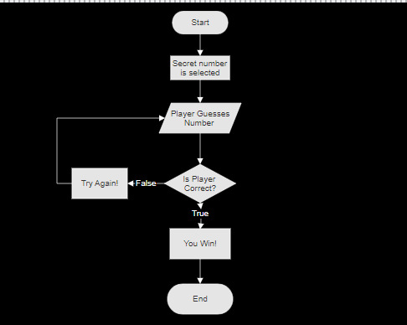
Guess Game Project Overview

Slide 16
Some things to Know
Print & Input
Variables
Operators
Integers and Strings
Conditionals
While Loops
The random Module

Slide 17
Print & Input
The Python print() function takes in any number of parameters, and prints them out on one line of text.
The input() function is used to take input from the user. Whatever is entered as an input is stored as a string.

Slide 18
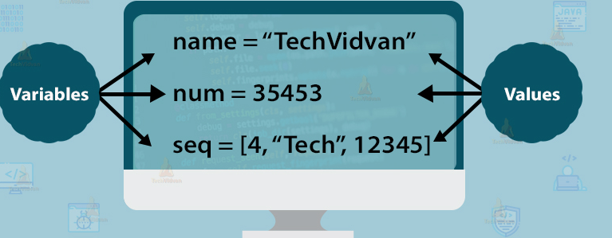
Variables
Variables can represent numeric values, characters, strings, and more. Variables enable programmers to write flexible programs because, rather than entering data directly into a program, a programmer can use variables to represent the data.

Slide 19
Operators
Operators are used to perform operations on variables and values. There are many Operators in python, but we will be looking at only a few:
Operator | Description | Example
+ | Addition | x + y
== | Equal | x == y
!= | Not Equal | x != y
> | Greater than | x > y
< | Less than | x < y
= | Assignment Operator | x = 3 assigns 3 to the variable x
+= | Increment Operator | x += 3 is the same as x = x + 3
and | Returns True if both statements are true | x < 5 and x < 10

Slide 20
Integers & Strings
Integers or int are whole number that can be positive, negative, or zero. Fractional numbers or decimals are not integers.
Examples: 0, 1, -2, -8, 12, -45, 15.
Stings are an ordered sequence comprised of a set of characters that can also contain spaces and numbers. Strings are commonly denoted by a set of single (‘ ‘) or double quotes (“ “).
Examples : ‘hello world’, “pizza”, ‘A slice of pizza’

Slide 21
Conditional Statements
Conditional Statements perform different actions depending on whether an argument evaluates to true or false. In python, conditional statements are handled by if, elif and else.
Syntax:
if x > y:
do something
elif x < y:
do something else
else:
do this if all conditions are false

Slide 22
While Loops
The while loop executes a set of statements in a continuous loop as long as a condition is true.
If at any point you would like the loop to end, you must include the break function.

Slide 23
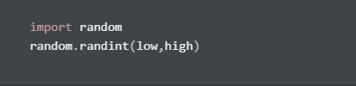
The random Module
A module is a python file that can be imported into a program to give a programmer access to extra functions.
The Random module is an in-built python module which is used to generate random numbers.
We will be using it in conjunction with the randint( ) method, which returns an integer from a specified range.

Slide 24
Learning Resources
Guess Game Code & Slides: https://github.com/camaison/Introduction-to-Python-using-VS-code.git
The “Take Your First Steps With Python Learning Path” by Microsoft:
https://docs.microsoft.com/en-us/learn/paths/python-first-steps/

Slide 25
Thank you!

